Slide 1
Image segmentation
Assignment 4
Luigi Quarantiello

Slide 2

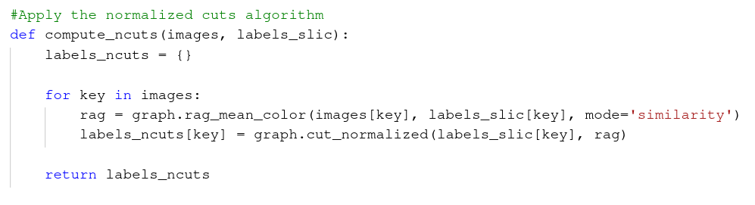
Normalized cuts - Code snippets

Slide 3


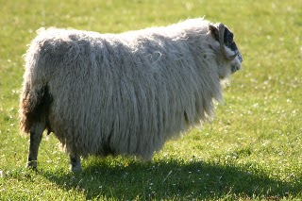


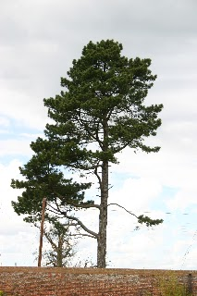


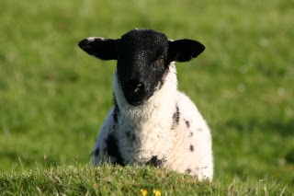


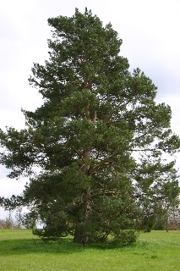





Normalized cuts - Results
26
13
27
5
14
20
21

Slide 4
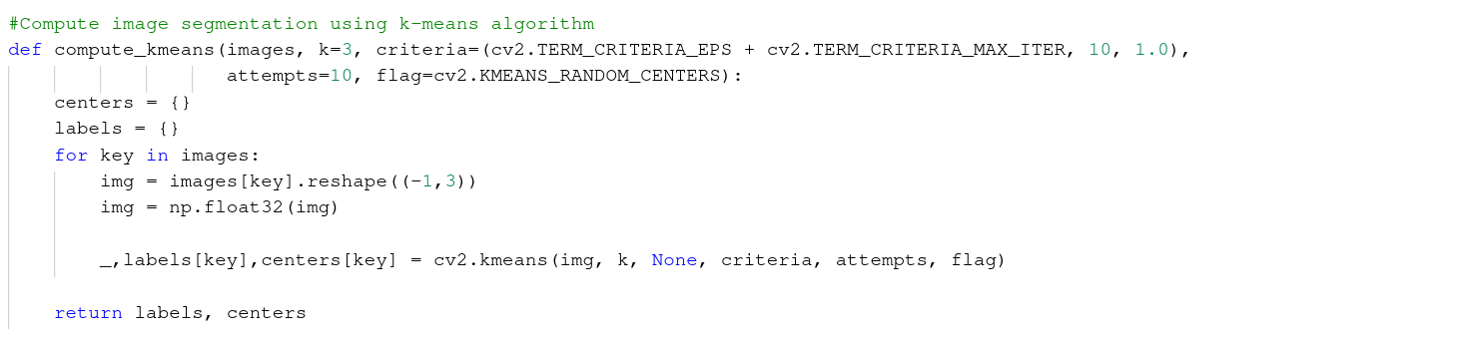

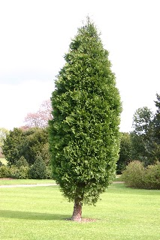





K-means segmentation - Code and comparison

Slide 5
Final
considerations
Ncuts segmentation
Produces results with a clear distinction between the various objects
Can be computationally expensive, but has good performances even with a small number of superpixels
K-means segmentation
Faster than the ncuts algorithm, but the results are less clear

